Slide 1
UnitB
Health, wellbeing and sport

Slide 2
Unit aims
You will explore the importance of physical activity and wellbeing for different types of participants and suggest ways to improve their physical and mental health status.
Learning aims In this unit you will:
Examine the importance of physical activity and sport
Investigate the importance of physical health
Explore mental health and social wellbeing
Undertake health and wellbeing screening and provide feedback to improve health status

Slide 3
A1: different types of active pursuits
Sport: Individual and team
Physical Recreation: E.G. walking and cycling
Outdoor Activities: E.G. rock climbing, sailing
Physical Education: In lessons at school
Physical Fitness: Increase fitness levels

Slide 4
A1: different types of active pursuits
Sport: Is it competitive? Is it an individual or team sport or both?
Outdoor Activities: e.g. rock climbing, sailing
Outdoor Activities: E.g. it can be played outside but is it adventurous?
Physical Recreation: Is it carried out in leisure time?
Physical Education: Is it carried out in PE lessons at school?
Physical Fitness: Is it played to increase fitness levels?

Slide 5
A2: categories of participants in physical activity and sport
Young people
People with a disability
People at risk of social isolation
How Can the Different Categories of participant take part in Tennis?
Categories of participant
People from different ethnic / cultural backgrounds
People at risk of offending
People aged over 50
People with a medical condition

Slide 6
A3: Benefits of participating in physical activity and sport
Physical, mental and social health
Physical health: to do with the body’s physical health and relates to not being ill
Mental health: relates to a person’s psychology and includes what they are thinking and how they feel about themselves as well as their emotional state
Social health: link to feeling at ease with other people and enjoying the company of others

Slide 7
A4: reasons for providing physical Activity and sport in the uk
BENEFITS OF LTA PROGRAMMES IN GB:
Social reasons
Health agendas
Community cohesion
Reduce crime
Employment opportunities
Alleviate work pressures and stress
? | Carry out research into the following LTA initiatives: LTA Youth Start Padel tennis Wheelchair tennis Initiative Advantage How do these support social reasons for providing physical activity and sport in GB?
LTA serves
Social Change Programme
Delivered in community centres e.g. youth clubs, faith centres, housing associations
For 8-18 year olds
Mental and physical fitness, life skills, and fun!

Slide 8
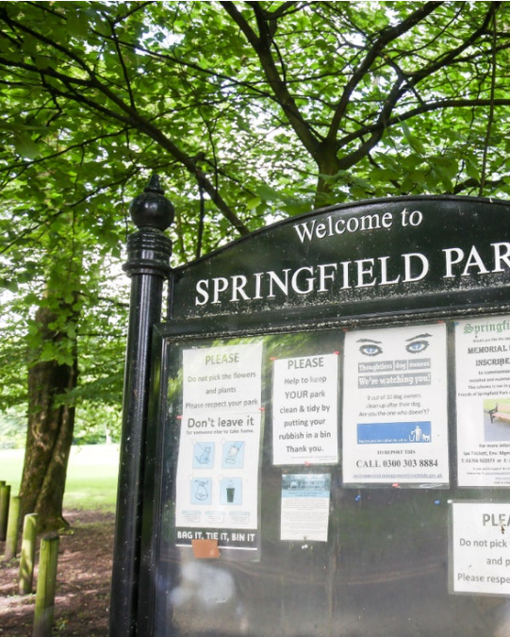
A4: reasons for providing physical Activity and sport in the uk
environmental
financial
historical

Slide 9
The ability of the body to function effectively
Ability to conduct day to day tasks
B1: definition of physical health
Ability to move freely
A state of complete physical, mental and social wellbeing and not merely the absence of disease or infirmity

Slide 10
How does
Taking part
tennis
in
Help improve
Physical
Health?

Slide 11
B1: definition of physical health
Indicators of good physical health
Moving freely
Ability to conduct day-to-days tasks
Free of non-sport specific aches and pains
Good balance
Can you identify three examples for each indicator of good physical health? | ?

Slide 12
B2: factors affecting physical health
Physical activity levels
Medical conditions
Stress
Factors Affecting Physical Health
Relationships
Diet
Consumption of alcohol and/or illegal drugs
Education levels
Work: sedentary or active
Smoking

Slide 13
B2: factors affecting physical health
Physical Activity
What types, and how much exercise per day should the following groups take part in: Children Adolescents Adults Adults aged 50+
Medical conditions
The following medical conditions can affect participation in physical activity: Diabetes Coronary Hear Disease Asthma Arthritis Discuss what the signs and symptoms are of each condition.
Diet
How many portion of fruit and vegetables should we eat each day? How much fluid should we take in per day? What foods contain saturated fat?
Stress
What is stress? What are possible causes of stress? What methods can be used to help to reduce stress?

Slide 14
B2: factors affecting physical health
Lifestyle
Do you have an active or sedentary job/ student life? Do you have a good work life balance? Do you get enough sleep? Do you have regular sleep patterns?
Alcohol Consumption
What are the government recommended guidelines for weekly consumption of alcoholic drinks for: Males Females?
Smoking
What types of diseases and ill health are associated with smoking?
Relationships
Relationships are with other people in your life. List the different types of relationship people can have and how they differ and offer support to each other.

Slide 15
B2: factors affecting physical health
Cyclical relationship between health, fitness and physical activity
Regular participation in tennis
Sedentary lifestyle
positive
negative
Increased levels of physical activity
Decreased levels of physical activity
Good health
Poor health
Increased levels of fitness
Decreased levels of fitness

Slide 16
B3: benchmarks of good physical health
Blood pressure
Resting heart rate
Body fat
Physical activity levels
Alcohol consumption
Sleep
Diet and hydration levels

Slide 17
B4: health monitoring tests
Blood Pressure
Manual sphygmomanometer and stethoscope Electric sphygmomanometer
Resting Heart Rate
Heart rate monitor Pulse – carotid or radial
Body Composition
Body Mass Index – height and weight Bioelectrical Impedance Analysis – electric current Waist to hip ratio – circumference of hips divided by circumference of waist
Lifestyle Factors
Questionnaires to include questions on: Alcohol consumption Typical daily diet Fluid consumption Sleep Physical activity levels

Slide 18
B4: health monitoring tests
Health monitoring test normative values 2021
Blood Pressure
120 / 80
Resting Heart Rate
60-80 bpm
Body Composition
Body Fat:
Essential fat Athletes Fitness Average Obese | Women 10-13% 14-20% 21-24% 25-31% >32% | Men 2-5% 6-13% 14-17% 18-24% >25%
Lifestyle Factors
5-17 year olds: 60 minutes per day 18-64 year olds: 150 minutes per week 65+ year olds: 150 minutes per week

Slide 19
B4: health monitoring tests
Health monitoring test normative values 2021
Alcohol consumption
No more than 14 units per week Several drink-free days a week
Sleep
6-9 hours per night
Diet and Hydration
Energy intake should match expenditure 2 litres of fluid per day No more than 10% saturated fat intake 5 portions of fruit and vegetables per day

Slide 20
Learning aim B: Investigate the importance of physical health
Effects of Regular Participation in Tennis on Physical Health
Blood Pressure and Resting Heart Rate: Tennis is an anaerobic and aerobic sport and will decrease blood pressure and decrease resting heart rate.
Body Composition: Decrease body fat levels from aerobic components of tennis and increase muscle tone and size from anaerobic components.
Lifestyle factors: Encourage positive lifestyle choices such as healthy diet, low alcohol intake, increased quality of sleep due to regular participation in physical activity.

Slide 21
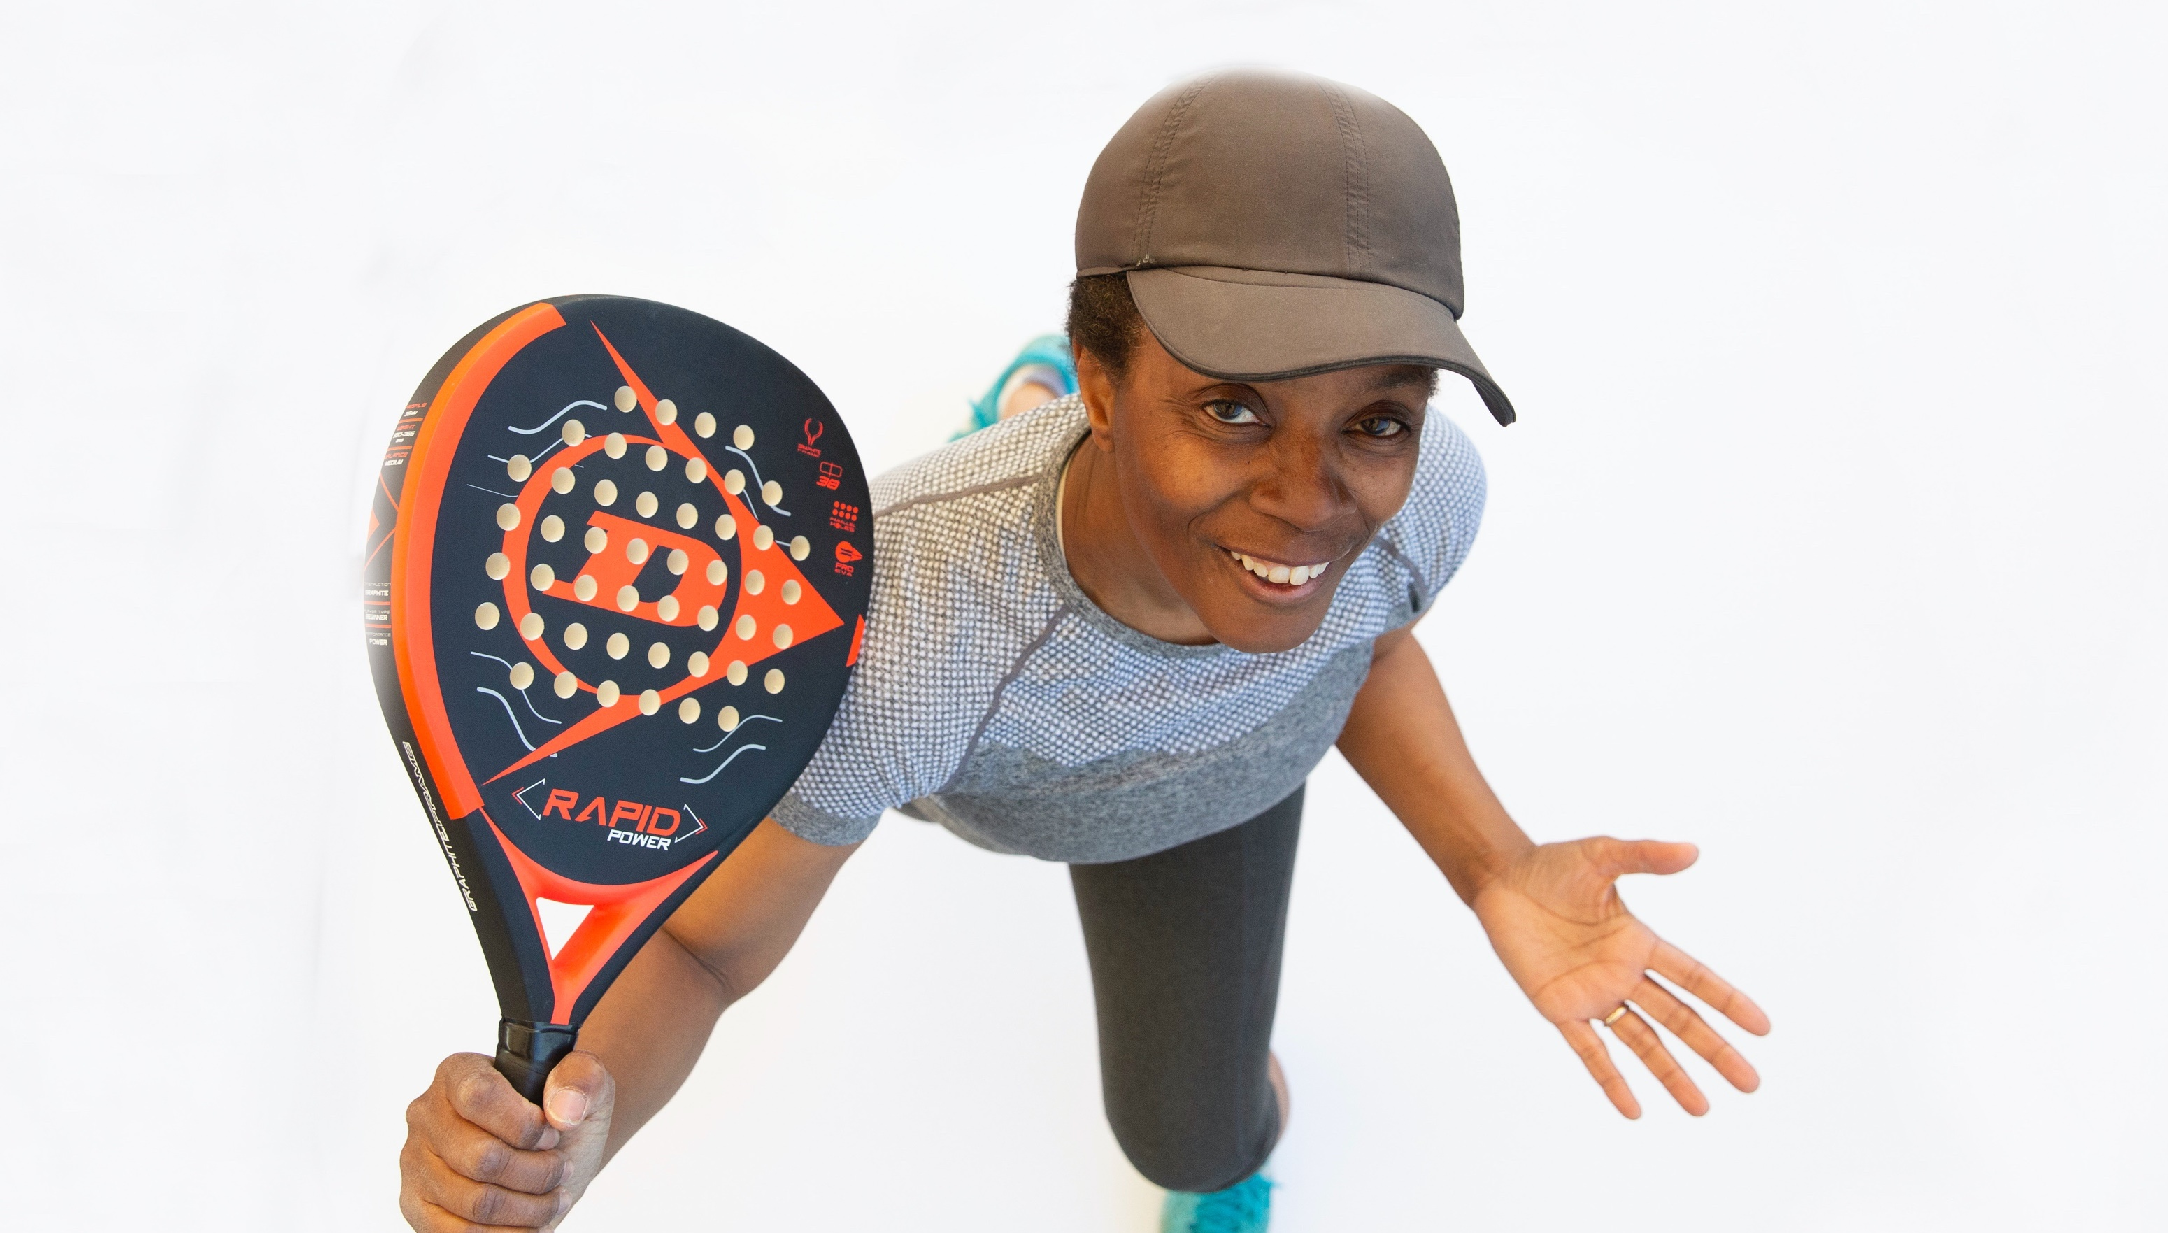
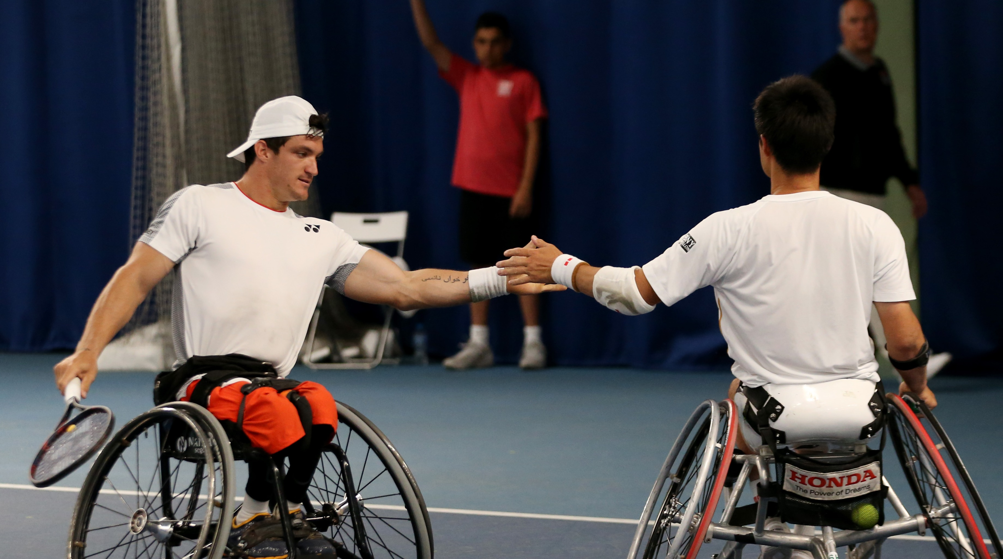
c1: definition of mental health & social wellbeing
Mental Health:
“Emotional wellbeing and resilience to adversity”
How can taking part in tennis improve mental health?
?

Slide 22
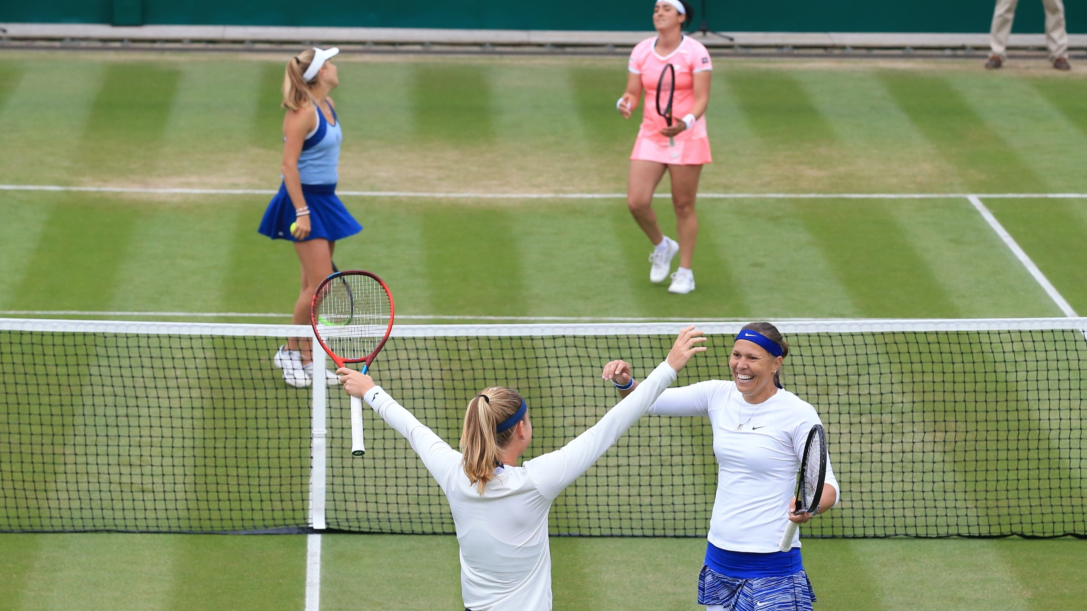
c1: definition of mental health & social wellbeing
Social Wellbeing:
“The ability to function in society and form relationships”
How can taking part in tennis improve social wellbeing?
?

Slide 23
c1: definition of mental health & social wellbeing
Indicators of good mental health
The ability to engage in conversation
The ability to maintain positive personal relationships
An awareness of mood state
Maintaining normal sleep patterns
The ability to cope with change
The ability to get out of bed in the morning
Hear how tennis helps mental health
Notes:
Link to video: https://vimeo.com/740364646

Slide 24
C2: factors affecting mental health and social wellbeing
Bereavement
Long term health condition
Drug or alcohol misuse
Social disadvantage, poverty or debt
Social isolation or loneliness
Factors Affecting mental Health
Childhood abuse, trauma or neglect
Significant trauma
Unemployment or losing your job
Experiencing discrimination and stigma
Domestic violence or bullying
Severe or long term stress

Slide 25
c3: signs and symptoms of poor mental health and social wellbeing
THE FOLLOWING ARE ALL SIGNS AND SYMPTOMS OF POOR MENTAL HEALTH:
Decreased personal interests
Reduced motivation
Poor hygiene
Depression
Anxiety
Substance abuse
Reduced sleep
Decrease in self confidence
Decrease in self esteem
Poor diet
Difficulties in personal relationships
Increased emotional stress
Increased irritability
Lack of patience
How could you identify if your tennis partner was showing any of these signs and symptoms so that you could offer support to that person? | ?

Slide 26
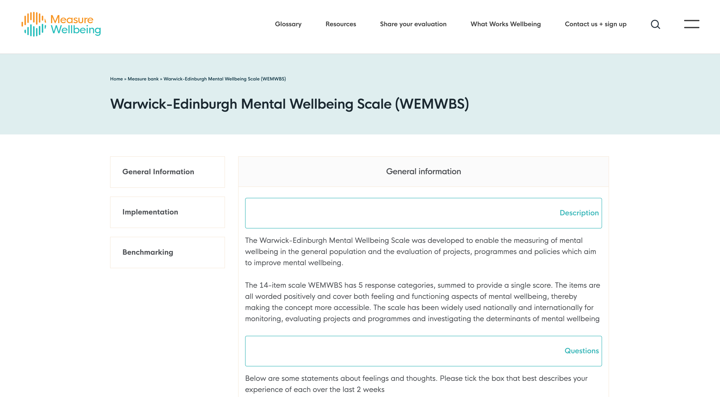
C4: measuring wellbeing
Wellbeing can be measured by using the Warwick-Edinburgh mental wellbeing scale (WEMWBS) and through one-to-one discussions.
The WEMWBS is made up of 14 positively worded items which can be used for assessing a population's mental wellbeing.
One-to-one discussions can be carried out by health professionals (doctors, psychologists and counsellors) and significant others (family, partners, teachers and coaches).
Notes:
https://measure.whatworkswellbeing.org/measures-bank/wemwbs/

Slide 27
C4: measuring wellbeing
Lifestyle indicators
Consistency of emotions
Emotional resilience
Desire to succeed
Open communication
Social interactivity
Health status
Ability to cope with change
Self-care
Workplace health
Why is it useful to measure lifestyle factors? | ?

Slide 28
D1: COMMUNICATING EFFECTIVELY WITH A CLIENT
?
Types of communication
Verbal:
Using spoken words
Consider your accent, use of slang words and technical terminology, tone and volume
Non-verbal:
Facial expressions
Body language
Hand movements / gestures
Eye contact
Think of a tennis example when you have used verbal and non-verbal communication.
What happened and why did you use those types of communication?

Slide 29
D1: COMMUNICATING EFFECTIVELY WITH A CLIENT
Building a rapport to put client at ease
Using conversation to engage a client
Sensitivity during health testing and difficult conversations
Assessing the facts and asking extension questions

Slide 30
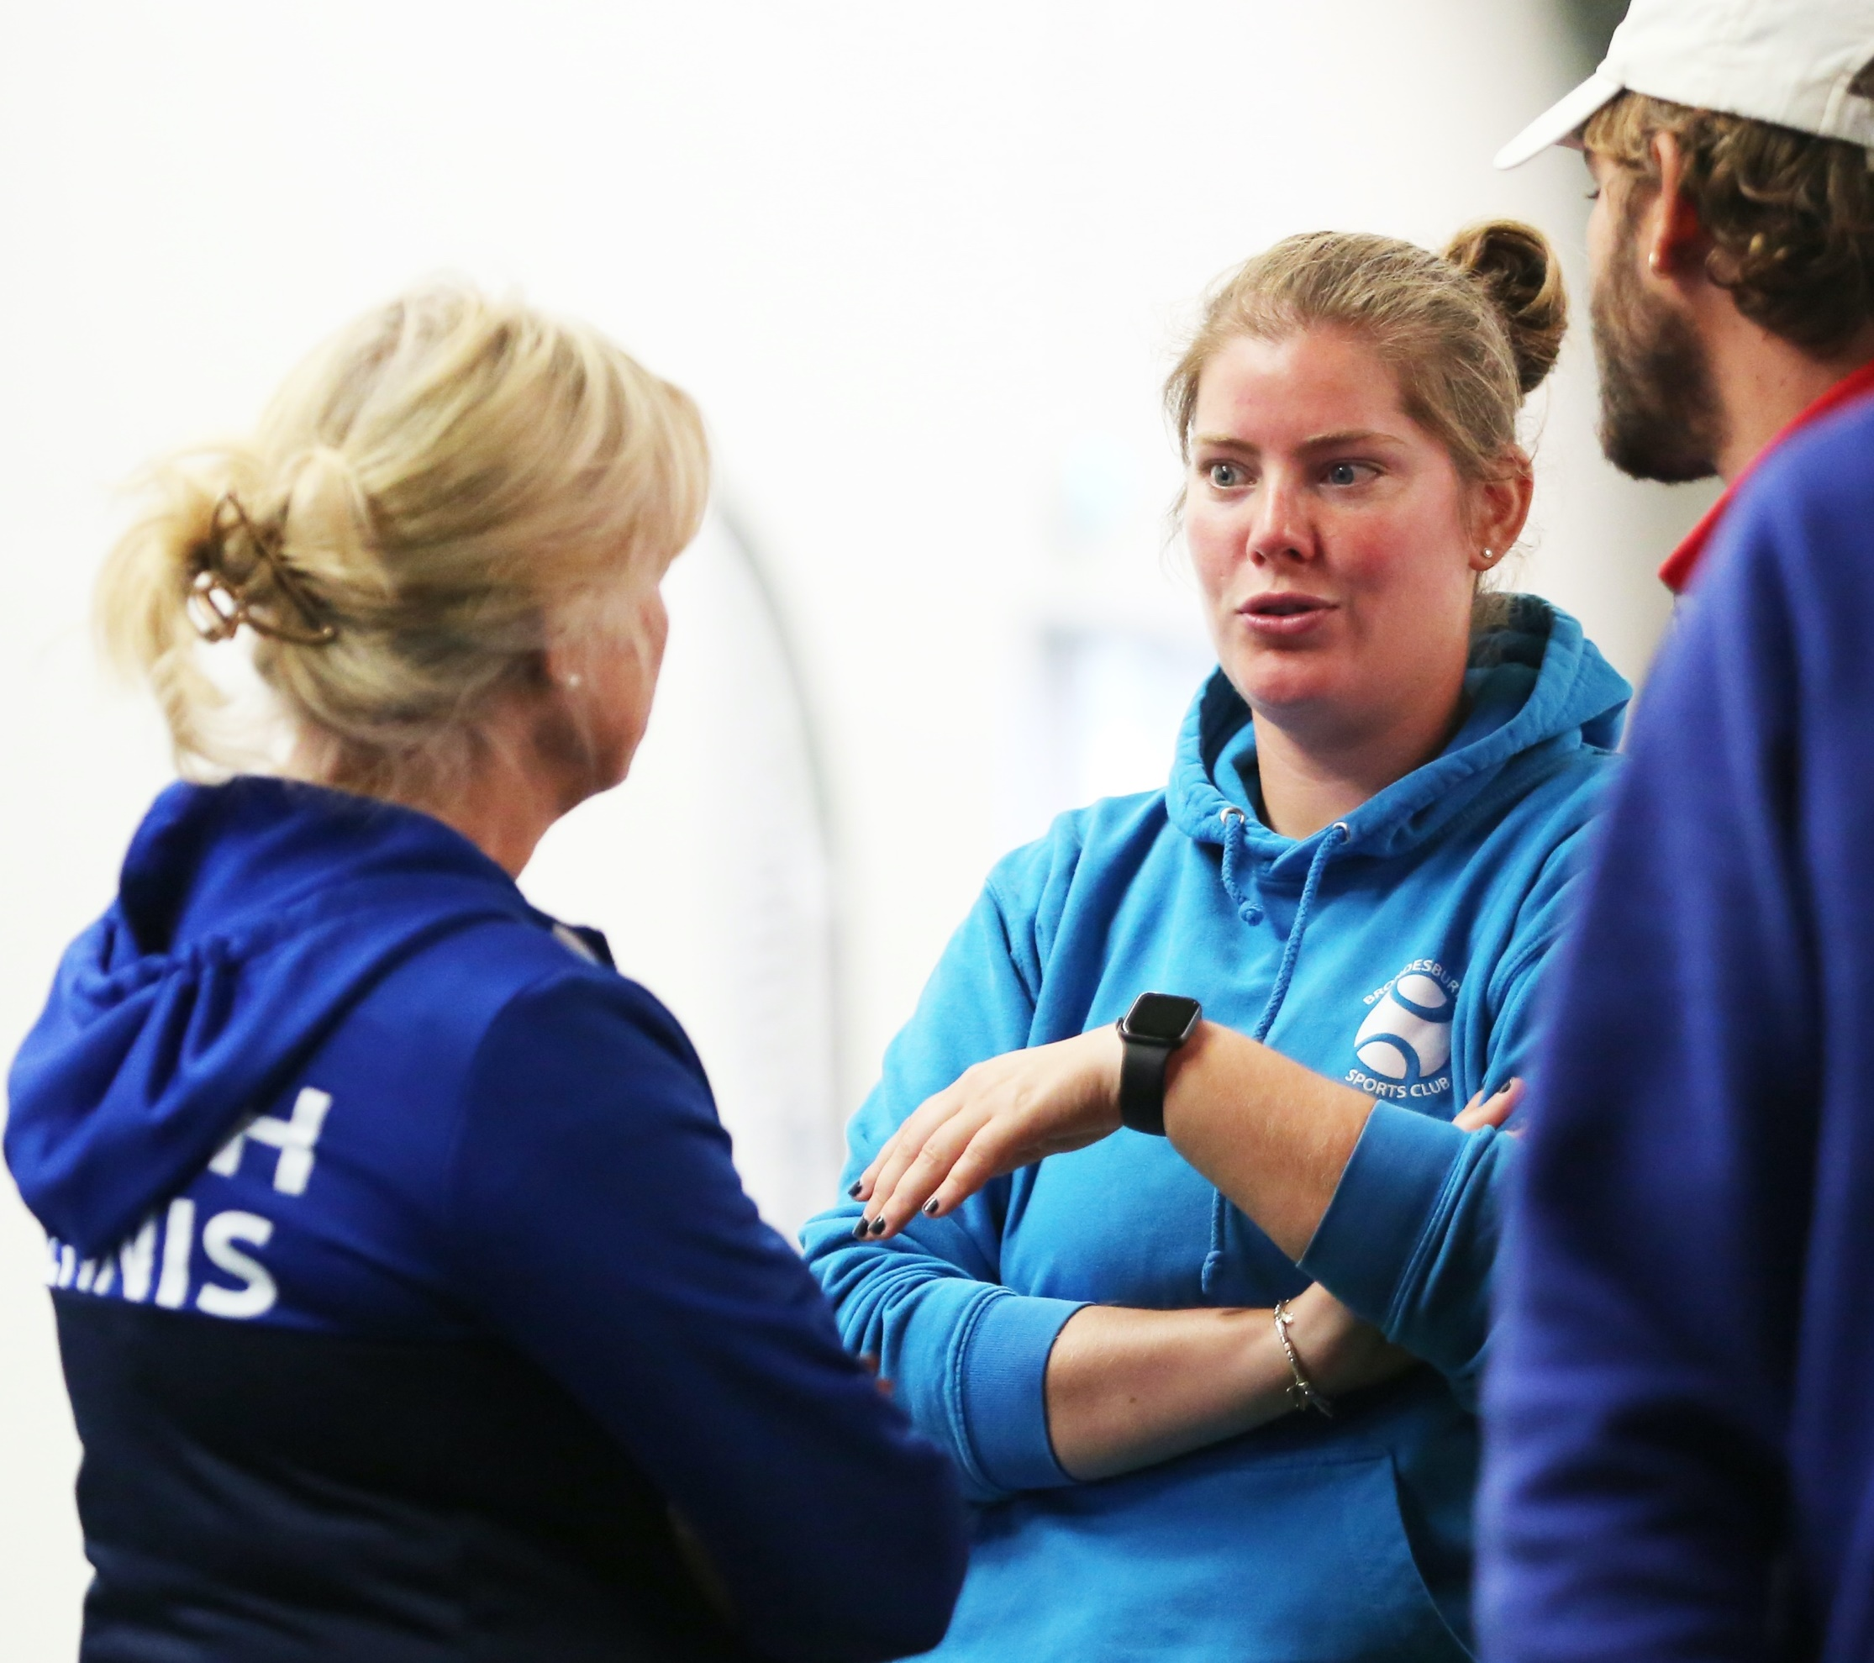
d2: undertaking health and wellbeing training
Using Customer Service Skills
Clear communication
Attentiveness
Use of positive body language
Friendliness
Responsiveness
Knowledge of the tests and procedures
Why do you need to be able to use these skills? What is the benefit to you and the participant? | ?

Slide 31
d2: undertaking health and wellbeing training
Conducting mental health and wellbeing assessments Consider and apply the below in your client consultation:
Questioning and Listening
Client confidentiality
Non-verbal communication
Informed consent

Slide 32
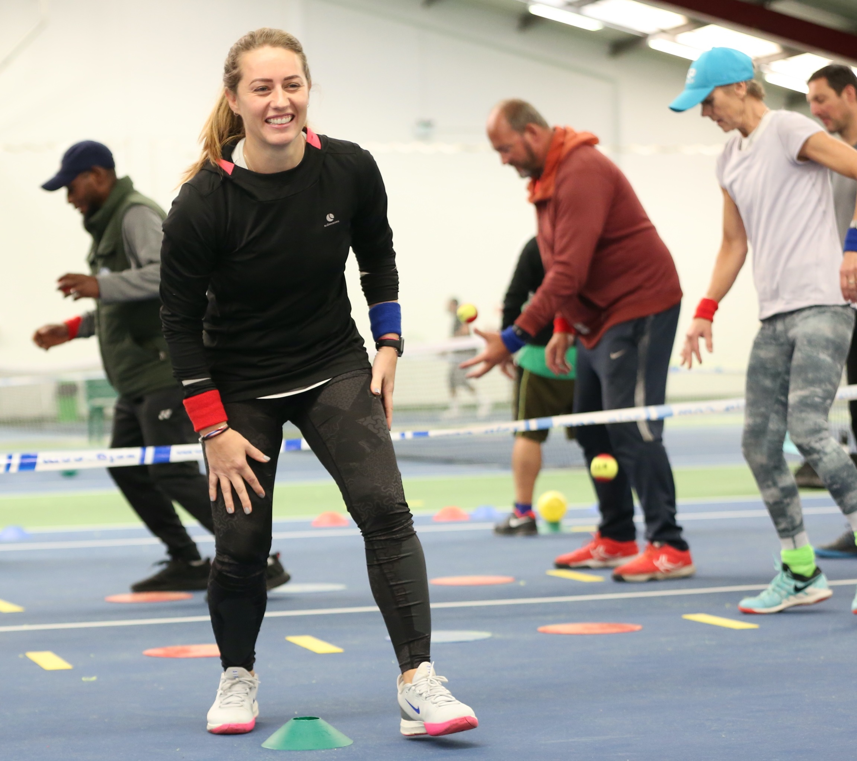
d2: undertaking health and wellbeing training
Processes for administering physical tests
Pre-test procedures
Maintaining clients’ dignity
Test sequence
Test protocols
Health and safety
Recording test results
Reasons to terminate a fitness test
Why is it important to always follow these processes? | ?

Slide 33
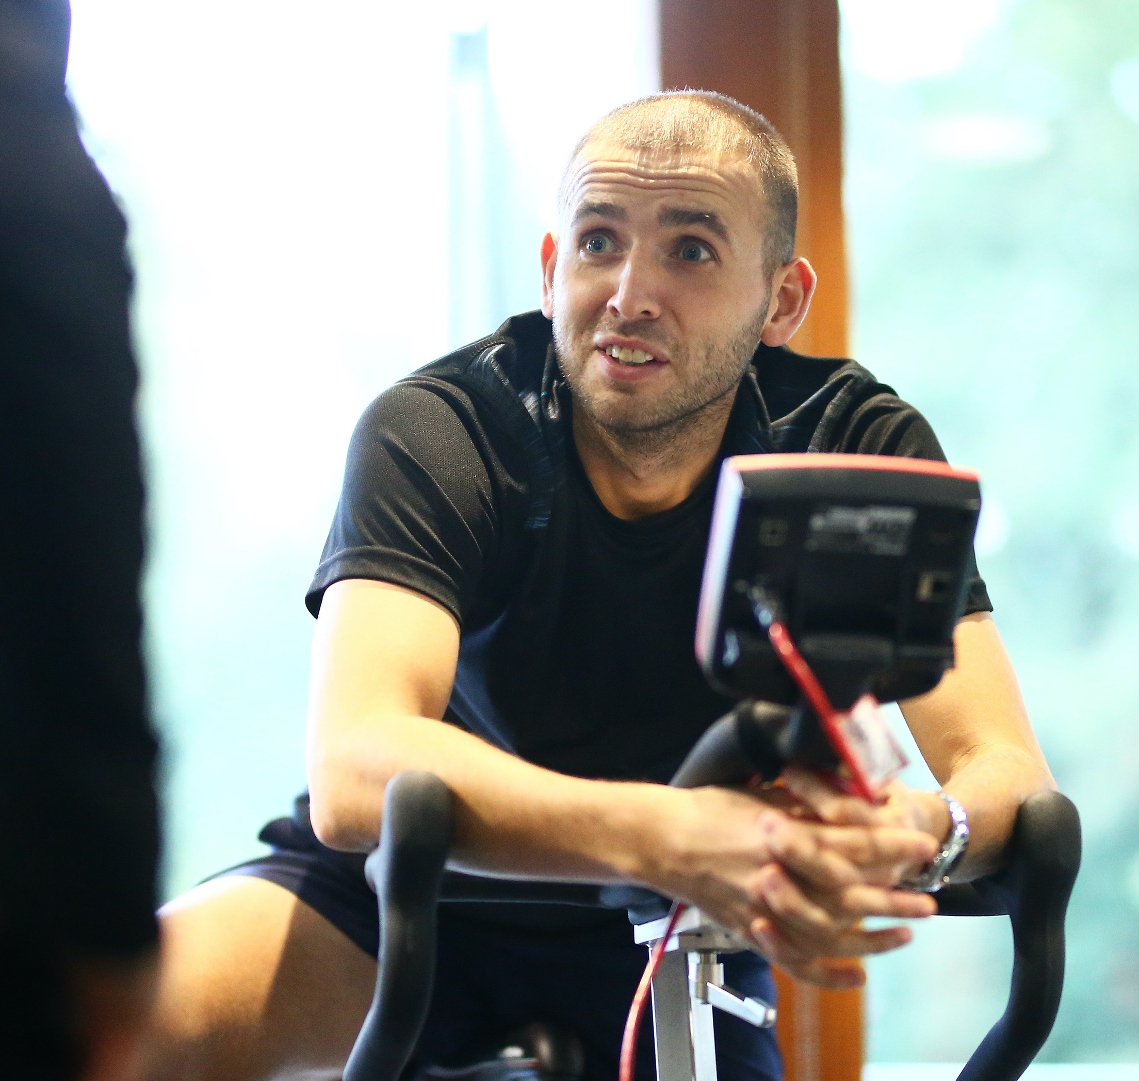
D3: Interpreting results against normative data
When you carry out tests you need to carefully record the data.
This will allow you to:
Compare it against normative data and make judgements on population norms
Compare it with accepted health ranges and national guidelines
Analyse zones of tolerance
Seek a medical referral if needed

Slide 34
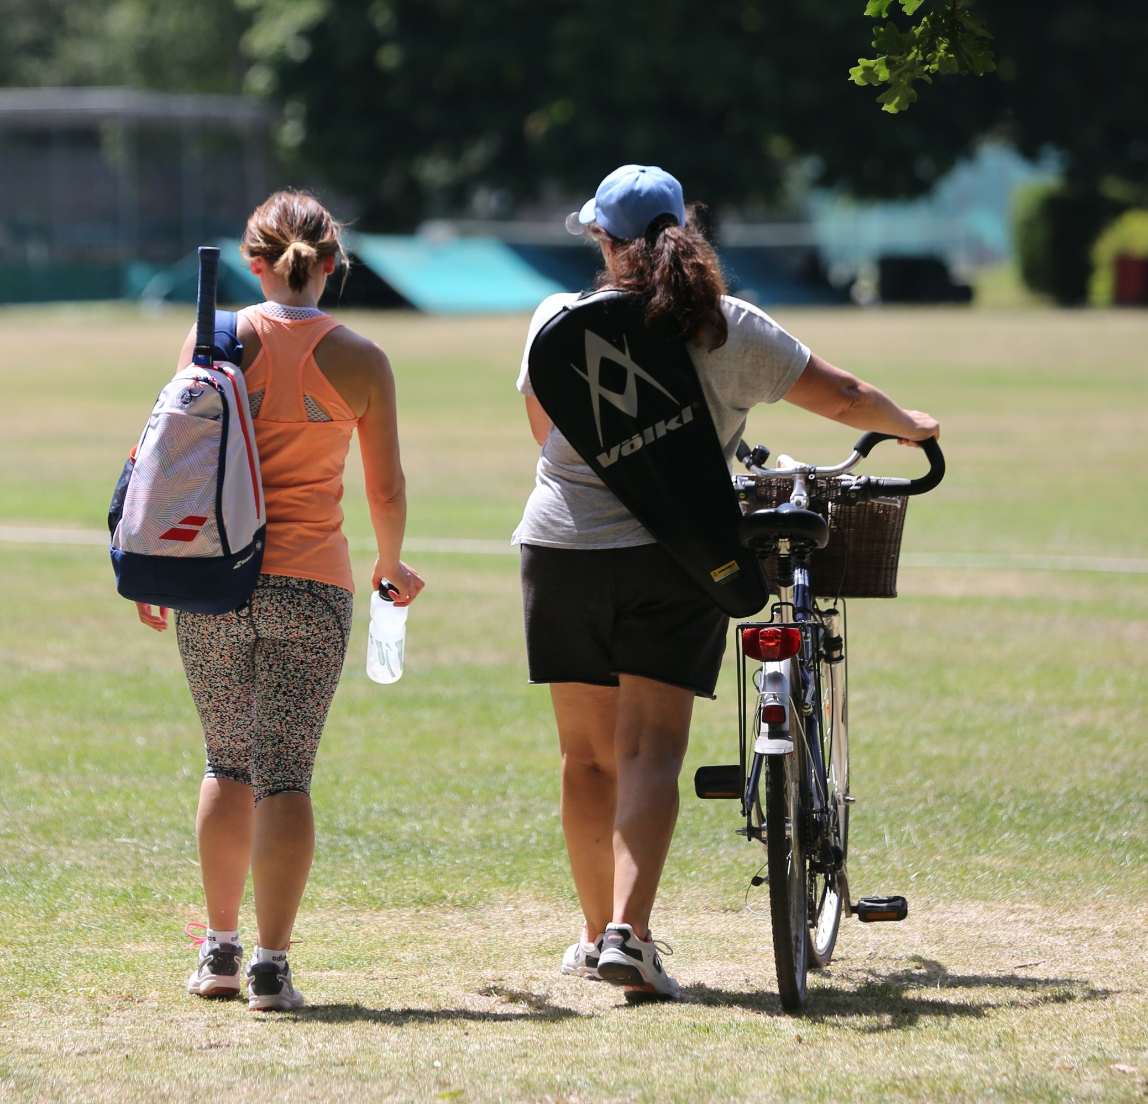
D4: Strategies to improve health status
Strategies can be used to successfully improve a participants health status. These include:
Physical activity guidelines (meeting national guidelines and national initiatives)
Getting outdoors
Relaxation techniques
Yoga and Pilates
Diet changes
Counselling

Slide 35
d5: feeding back health status to a client
It can be difficult to give feedback to a client, especially if it is news they are not expecting. You need to:
Select an appropriate location to give the feedback
Use positive body language
Use graphs to give a visual representation of health status
Decide whether to use verbal or written feedback
Use test scores and comparisons to national data
Identify strengths and areas for improvement
Make links to physiological and psychological factors
Give suitable recommendations to improve health status

